Slide 1

Oxathon
A hackathon of demographics, algorithms, and optimization

Slide 2
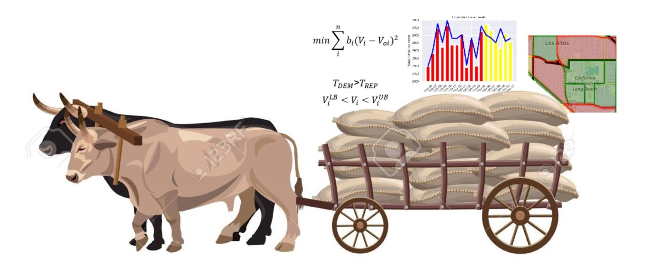
Oxathon

Slide 3
Diverse Projects
Modeling demographics and perturbations with neural networks
Cost minimization voting strategy
Crime modeling and prediction
Voting trend derivation
Cement mill simulation and model correlation
Demographic clustering to minimize different campaign strategies

Slide 4
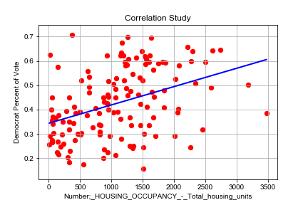
Modeling demographics and perturbations
Linear multivariable statistical models are used to model the effects of demographics on voting patterns or crime. However, these linear models do not accurately capture outputs to an exact enough degree, shown below, to produce high quality results. And perturbations of one demographic factor changes all outputs the same.
This effort uses a multivariable neural network to produce an output, such as voting patterns or crime, based upon the demographics.
In addition, perturbations to the baseline demographics are shown to produce different outputs for each geographic area.

Slide 5
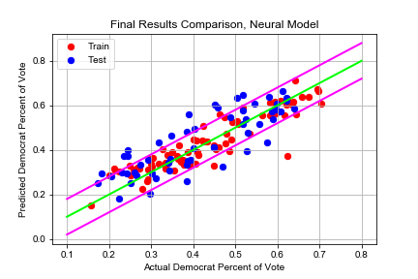
Modeling demographics and perturbations
A neural network with four hidden layers and 8, 24, 24, and 16 hidden neurons was used to map demographic statistics to the voting record on a precinct-by-precinct basis. The mapping, shown below, produces results within a fairly tight tolerance band for data in the training set and in the test set. This model can be used to generate policy to enhance the area.
Furthermore, perturbations to the baseline demographics are shown to produce different outputs for each geographic area. Thus capturing an output, such as a voting record, being a nonlinear mix of demographics.
Changes in demographics are easily incorporated into new policies.

Slide 6
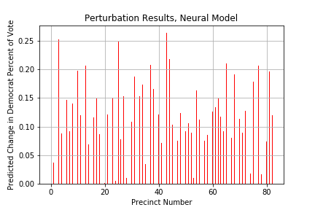
Modeling demographics and perturbations
The neural network model of demographic effects on an outcome lend themselves well to perturbations in the demographics. For example, suppose the number of African American population increases in a precinct by 5%. What is the effect on the previously trained outcome such as crime or voting patterns?
The figure shows the effect of a 5% increase in African American population in each and every precinct (one at a time). The resulting change in Democrat voting percent is shown. As expected, some precincts show large increases in Democrat voting and others show little.
This method can direct policy or campaign strategies due to changing demographics.

Slide 7
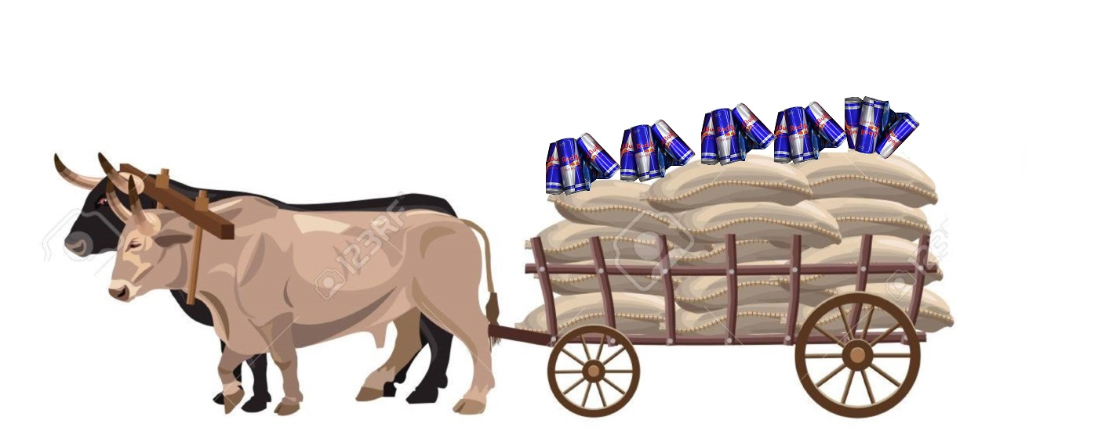
Refreshments

Slide 8
Cost minimization voting strategy
This effort makes a first effort at developing a methodology of how and where to spend limited resources in order to maximize the chance of winning an election. The methodology assumes that the election “is within reach” and that targeting specific voters and precincts can get the win.
The calculation of which precincts to target was posed as the constrained minimization problem to minimize the changes in precinct voting percent yet still gain enough votes to win the election.
In words, the algorithm is trying to find the least percent changes in vote for each precinct in order to make the overall Democrat vote total exceed the overall Republican vote total. In addition, lower and upper bounds on the percent Democrat vote are enforced to provide realism.

Slide 9
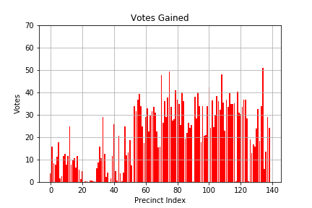
Cost minimization voting strategy
The voting strategy algorithm was demonstrated on the 36th California Assembly district. Demographic data, past voting data, and geographic data was used to developed the cost minimization problem, penalties for excessive swings in voting, and presentation of the results.
The algorithm found the precincts that are beneficial to spend more time and money on in developing a campaign strategy to win an election. Feasible strategies were found that produced winning elections. The winning strategy was fairly robust in that multiple winning paths could be found.

Slide 10
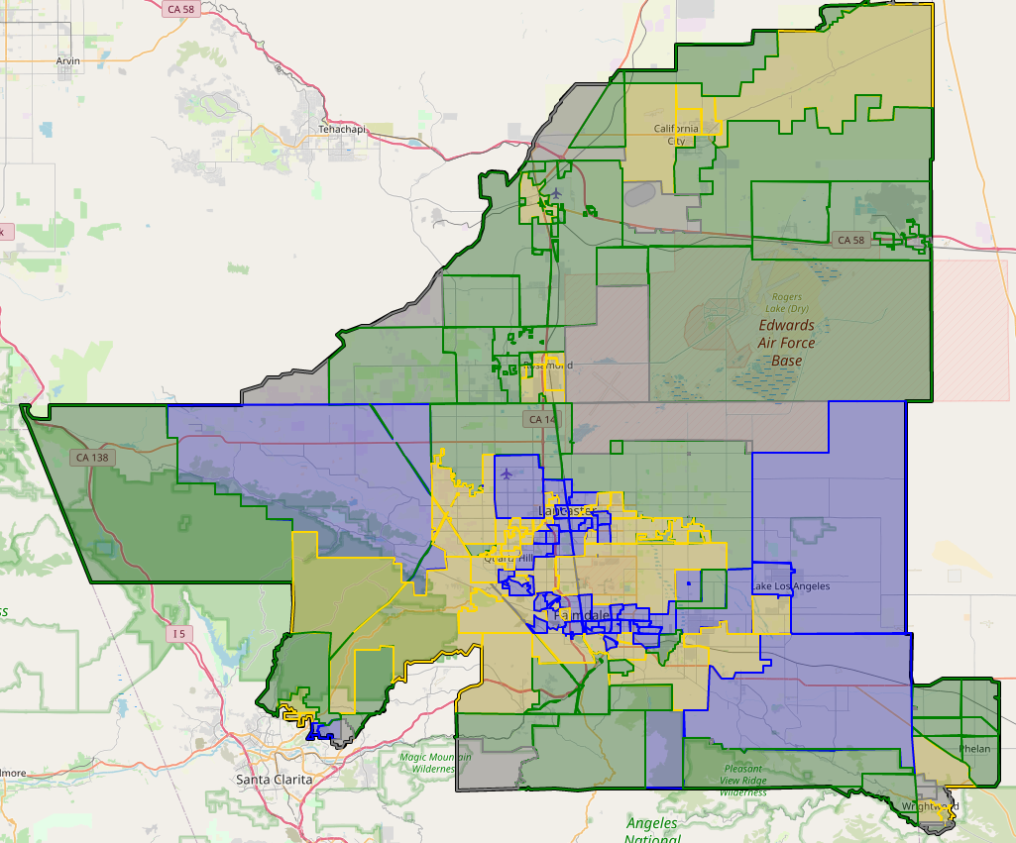
Cost minimization voting strategy
The voting strategy identifies precincts where the most bang for the buck is obtained.
The blue precincts show areas where the most extra votes are obtained, followed by gold, and then green.
Campaign strategies utilizing the precinct demographics and geographic location can win previously lost elections.

Slide 11
Crime modeling and prediction
“All crimes are local.”
Whether you agree with this statement or not, there are many different methods to model historical crime and to try and predict future crime. These methods range from statistical methods to system dynamics methods to geographical methods. Some of these methods look at certain geographical areas and treat them independent from other areas and others consider each geographical area connected to some or all other geographical areas.
Most of these models match fairly well-known characteristics of crime (Ref. 1). Namely 1) crimes clustered within 1-2 months of a previous crime, 2) crimes tended to cluster up to 300-400 meters of a prior crime, 3) repeat victimization tended to occur in more deprived areas, 4) space-time clustering was more evident in affluent areas.

Slide 12
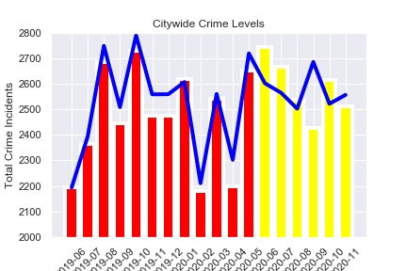
Crime modeling and prediction
The effort uses an Independent Crime District (ICD) methodology. That is, the crime in a geographical district only depends on the features and inherent characteristics of that specific district. There is no direct connection to neighboring geographical areas. The methodology relies on matching a number of damped oscillators to past crime levels for a given geographic area and then projecting forward.
The algorithm is trained on the most recent twelve months of data and predicts the future six months of data.
The method inherently recognizes past cycling crime trends and uses them to project forward.
The method can advise optimal resource utilization by public safety departments.

Slide 13
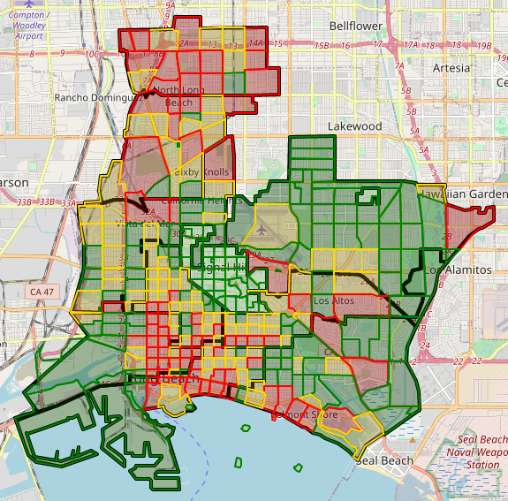
Crime modeling and prediction
The predicted crime levels from each Independent Crime District can be stitched together to produce predicted crime levels across the entire city.
Furthermore, maps of crime in the city can be predicted to help public safety officials deploy resources efficiently.

Slide 14
Voting trend derivation
There are many factors that affect voting trends such as changing demographics within a precinct, increases of people at the minimum voting age, and the interest by voters in a specific race. These trends may or may not be explained by changing demographics. More people at the minimum voting age is explained by changing demographics but an increase of voter interest in a race may not be.
Regardless of the cause of voting trends, the results are interesting to people running for office, general voters, and people donating money or time to political races.
This effort is purely a display of voting trends.

Slide 15
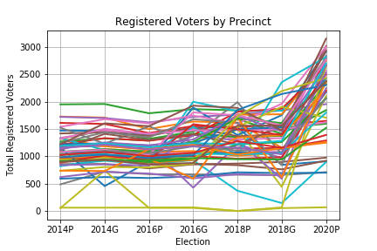
Voting trend derivation
Data from the Redistricting Database for the State of California was downloaded and parsed down to the 36th California Assembly district precincts. The 36th California Assembly district races over the years have been very interesting with the seat changing hands and being defended by the two main political parties.
The figure shows a steady number of registered voters across all precincts until the 2020 primary election. At the 2020 primary election the number of registered voters increased significantly.
Inidividual precincts could be examined in detail to try and determine the cause of increased registrations.

Slide 16
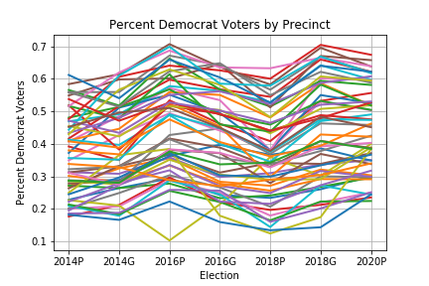
Voting trend derivation
Despite the significant increase in registered voters as shown on the previous chart, the percent of registered Democrat voters stayed the same for most precincts.

Slide 17
Cement mill simulation/correlation
Cement and mining mills produce much of the materials needed to build the world’s infrastructure. Yet the basic process of grinding down to cement powder is not well understood. The chaotic trajectories and impacts of the stainless steel media are not as well understood as hoped.
This effort develops a simple rigid body simulation for the trajectory of the media. The trajectory is based upon free-fall, contact, product friction, and centrifugal force.
The simulation is guided by test data from a cement mill as it empties and fills.

Slide 18
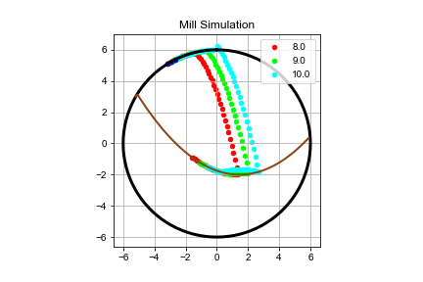
Cement mill simulation/correlation
The basic centrifugal force, free-fall, impact with product, and ride up the product level has been developed as shown below. The final stage of the simulation where the media “rides up the mill liner” was not finished. Inelastic impact modeling was also not finished. Mill log data for appropriate processes was obtained and reformatted for use in correlating the simulation.
This effort develops a simple rigid body simulation for the trajectory of the media. The trajectory is based upon centrifugal force , free-fall, contact, and product friction.
The simulation is guided by test data from a cement mill as it empties and fills.

Slide 19
Cement mill simulation/correlation
Great progress was made on the cement mill simulation and model correlation but was not completed. Both the physics of the media/product slurry interaction and processing the large amount of measured mill data held us back.
The media/slurry interaction is an inelastic impact problem that will require more time to incorporate into the simulation.
The measured data needs to be windowed for full or empty mill conditions and used to correlate the simulation.
These are doable tasks.

Slide 20
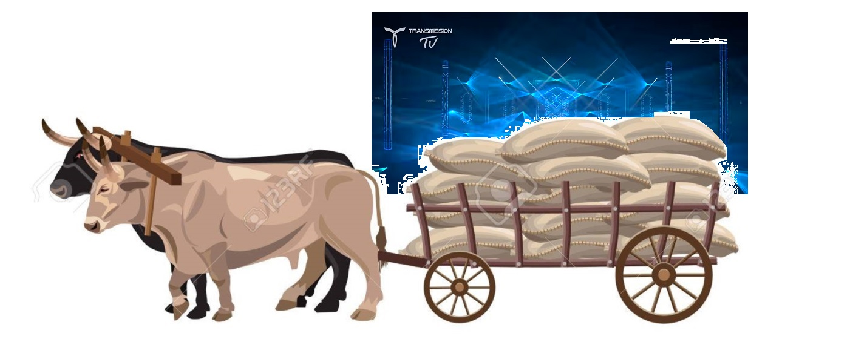
Energy-inducing entertainment
Status

Slide 21
Demographic clustering
Linear multivariable statistical models are used to model the effects of demographics on voting patterns or crime. However, these linear models do not accurately capture outputs to an exact enough degree, shown below, to produce high quality results. And precincts or census tracts with similar demographics to each are not identified.
K-means clustering and Gaussian mixture models are methods of clustering data into similar subsets. These methods can be used to group precincts based upon a high dimensional set of demographics.
Clustering similar precincts together would be another method of deploying similar campaign strategies across like-minded precincts and being more efficient than a “one size fits all” across all precincts (regardless of demographics).

Slide 22
Demographic clustering
No significant progress was made on this effort.
Look for results in the future.

Slide 23
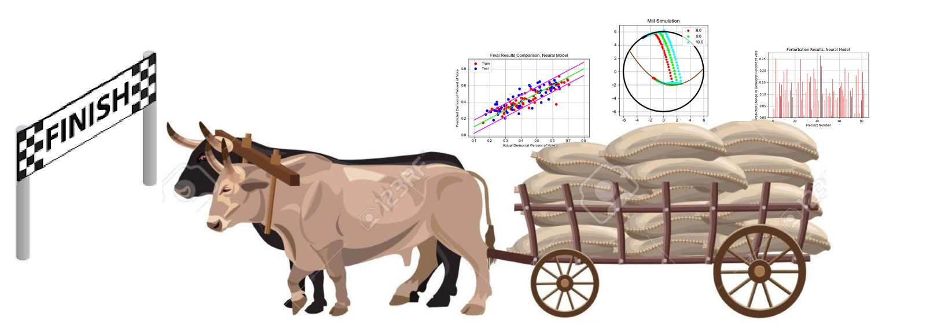
The finish line

Slide 24






Our Partners

